Slide 1
Simplified
Acquisition of
Base
Engineering
Requirements

Slide 2
Overview
What is SABER Air Force-Wide?
Eielson AFB & 354 CES Mission Overview
What is SABER at Eielson?
Questions/Comments

Slide 3
Introduction
Simplified Acquisition of Base Engineer Requirements (SABER) contracts provide a streamlined means to complete minor construction projects estimated at less than $750K.
Contracting personnel and civil engineers are encouraged to adapt their SABER-like acquisitions and processes to meet their local needs and the local environment.
Notes:
So let’s start going through this guidance, starting with the introduction.
The IG guidance is nice because it is short, straight to the point, and minimizes fluff. The very first sentence already provides some good info: SABER contracts provide a streamlined means to complete minor construction projects estimated at less than $750K. A couple of things to consider regarding this:
-The 2011 version of this guidance was the first to mention this ‘threshold’. In the past, I have heard stories of people using SABER to accomplish very large construction projects that go into the realm of MILCON (Yes, they acquired Congressional approval for a construction project that was accomplished with SABER). This goes against the intent of SABER, which really is ‘simple’/small minor construction projects.
-The other key point is that the minor construction limit is no longer $750K – the limit changed to $1M this past year. I assume that the next version of this guidance will update this number to $1M. In the interim, however, a contracting officer will have to determine if a project between $750K-1M will meet the intent of your SABER program. This provides a good segue into the second half of the introduction paragraph, which states:
“Contracting personnel and civil engineers are encouraged to adapt their SABER-like acquisitions and processes to meet their local needs and the local environment.” The point of SABER is to make things easier for everybody involved – we are given a significant degree of freedom to implement SABER at our installations.
Despite what this guidance states, SABER does not necessarily have to be ‘strictly’ for construction. It could also be utilized, potentially, for repair or maintenance type of work. Keep in mind that all work should be classified properly as either Maintenance, repair, or construction per programming rules – and the appropriate funding approval thresholds need to be followed in order to keep yourself (and your Commander) out of prison.

Slide 4
SABER History
Started Jan ’87 during drawdown
  Patterned after Army’s JOC
Approved AF-wide, late ’87
  McClellan AFB first test run
Still needed oversight after several court decisions regarding competition (1991)
General Guidance → AFFARS (1994)
  AF Federal Acquisition Regulations
AFFARS → Inst. Guidance (2002)
Notes:
Before moving on to talk about some SABER definitions, lets jump out of the Informational Guidance and look at the history of how SABER came into existence.
The Army starting using what they called Job Order Contracting (JOC) back in the mid-80s. We saw what was going on, and thought it would be good to model that for the Air Force. But of course we couldn’t also call it JOC, we had to make our own name to stand out. I’m not certain, but I assume that we came up with the name ‘SABER’ first, and then made up the words later for what each letter stands for.
Drawdown in military at that time but requirements not decreasing (mid to late 80’s)
McClellan first test run of SABER for AF – 1987
Immediately, Association of General Contractors lobbied Congressional Committee on Small Business and cried foul. Why?
Claimed destroying competition of small business person. Small contractor couldn’t get bonding capacity for large contracts – they wouldn’t have any problem getting bonded for any of the small Task Orders, but lumping everything into one large overarching contract for a long period of time was exclusive for some smaller construction businesses.
(Small Business Specialists typically review all requirements over $10K, to determine if they should go to a small or disadvantaged business – but SABER takes this option out of play.)
2) Design issues – contractor concerned about design liability because they are expected to do some design but don’t have professional A-E licensing. Would a contractor get in trouble if the small design they performed would prove faulty? We’ll talk more about the design limits later in this lesson.
Committee asked GAO (general accounting office) to look at these problems. Results - all thrown out
1) Small businesses still get business because SABER acts as a general contractor, smaller businesses can be a subcontractor. In my opinion, this is very surprising – I would not expect a ruling to choose in favor of SABER since to me, it just seems inherently unfair to lump all kinds of work into one contract. However, it happened, which was good news for the Air Force since it really simplifies the contracting process.
2) design – we don’t ask for anything requiring professional A-E services
Every complaint thrown out and within 1 year, SABER contracts initiated at 70 installations
1991- getting out of control – audits begin. AFAA follow up stated…
1) too much design
2) manipulating price book
3) DOs too large (they were capped at $200K at that time)
SABER guide was result of AF audit. No teeth though.
1994 – IG – resulted in taking guide and placing in AFFARS. Became the DD Appendix. Now it had teeth (regulatory)
Jun 2002 – pulled out of AFFARS…no more regulatory guidance on SABER. Many of the limitations on SABER removed. Potential for abuse increases.

Slide 5
Purpose of SABER Program
SABER contracts expedite award of civil engineer (CE) requirements by reducing CE design work and acquisition lead-time
  Single or multiple award contract
  AFFARS MP5316.504 requires minimum amount DO issued as obligation at contract execution
  Close contractor office (long term commitment)
  Best suited for non-complex, minor construction, and minimal design maintenance/repair projects
  Typical project $50K-$500K
Notes:
So following definitions, the IG goes on to discuss the purpose of the SABER program.
The first sentence here really drives home the main benefit: “SABER contracts expedite award of civil engineer (CE) requirements by reducing CE design work and acquisition lead-time”.
The ability to quickly award individual task orders vs having to submit and advertise an RFP for every little project is a huge advantage for us in CE.
The guidance also states that it can be single or multiple award contracts. So this means that you could have one SABER contractor, but you can also have more than one. When you hear multiple award, you probably think of MACC. However, SABER can also have more than one contractor, and I have seen instances where bases have more than one SABER contractor – though this is rare.
The bases I have seen that have more than one SABER contractor, they tried to split the work out equally between the 2 contractors. Inevitably, one contractor became the ‘good one’ and started receiving the high-focus or critical work, while the other contractor was labeled the ‘bad one’ and got the other work. This is not the intent of multiple award SABER contracts – there should be a clear way to define who gets assigned the various task orders that are generated.
It may be beneficial that if you have more than one SABER contractor, that they are different in that maybe one is specialized in horizontal work (like pavements or utilities), and the other gets all the vertical work (like facilities). However, there are multiple ways to make the determination, depending on what your contracting officer is willing to accept.
The AFFARS mandates that a delivery or task order should be obligated upon contract execution. When you advertise a SABER contract to have contractors bid on it, you do so with an existing TO to show as an example. This is sometimes called the ‘seed’ project, or the first project, and should be ready to execute immediately upon creating a SABER contract. If you don’t have any requirements that you can use as a seed project, then quite frankly, you have no reason to create a SABER contract.
Ideally, the SABER contractor should have an office or work area on or near the base. The goal is to establish a long-term relationship with the contractor, and being able to easily contact and communicate with them on a regular basis is critical to success.
Again, SABER should be for simple projects that do not require a significant design effort – and the guidance states that typical projects or Task/Delivery Orders will be in the $50-500K range.

Slide 6
Purpose of SABER Program
Successful SABER can Provide
  Improved service/response (timeline)
  Improved working relationships
    CE - Contracting - Contractor
  Reduced administrative burden
  Incentive for contractor to perform
    More projects
    More money
  Additional BCE resource (non-deployable)
  Fiscal Flexibility (Associate unit funding)
Notes:
If SABER is working properly, there is less workload for government personnel – as well as faster timelines. The contractor should be incentivized to perform in order to retain the contract for future option years.

Slide 7
SABER Definitions
SABER Contract “generally means”
  Firm Fixed-price, indefinite-delivery/indefinite-quantity (ID/IQ)
  Key features of a SABER contract
    MACC vs SABER
    Unit Price Guide (UPG)
    Coefficients
    Non-Pre-Priced Items (NPIs)
    Liquidated Damages
    Minimum Design
Notes:
SABER is what we call an IDIQ, or indefinite delivery indefinite quantity contract.
A normal IDIQ focuses on work that can be accomplished by a single trade (ie carpet or roofing IDIQ). Many bases have a Carpet IDIQ set up – you know that in any given year you will have to replace a lot of carpet on your base – but you just don’t know how many requests you will get exactly (indefinite delivery) and you don’t know how large each request will be (indefinite quantity). It would be terribly inconvenient to have to set up a new RFP and bid out carpet work for every time a request comes in. So you set up a Carpet IDIQ with a contractor, and agree to a predetermined price per SF of carpet, to have them replace carpet at your installation for a given period of time.
That same basic logic carries over to SABER – however note that SABER should not be used for single-trade work. It is designed for simple, multiple-trade work (a SABER contract is typically a general contractor, and may subcontract out much of the work). It is not cost effective to accomplish single-trade work via SABER.
When I say ‘Simple multi-craft work’, your mind may automatically think Troop Training Project. Recently, the Operations Flight reprioritized how they accomplish their shops’ work. Emergencies are still priority 1, but Troop Training Projects, or Multi-Craft Work Orders, are now priority 2. Your installation should be having your Operations Flight do multi-craft work orders on a regular basis, in order to keep our Airmen trained and knowledgeable when it comes to working with other shops. However, our Ops Flight isn’t manned or equipped to handle every single simple multi-craft work order request, so SABER can help out to ‘shoulder the load’, so to speak.
If you want have several ‘complex’ multi-craft work requirements, that is what a MACC is for. More information on SABER vs MACC can be found on the following slide.
Typically, when we talk about IDIQs and SABER, we have one initial year, with up to 4 follow-on optional years. This encourages the contractor to perform well in order to retain the contract for the full 5 years.
The IG also states that SABER contracts are generally Firm Fixed-Price. What does this mean? Let’s discuss this, along with some other key features of SABER listed here, in the following slides.

Slide 8
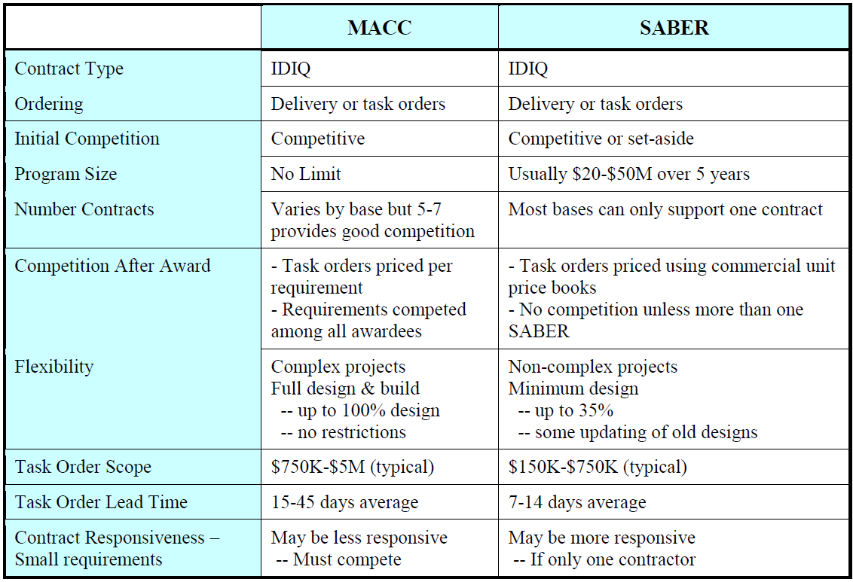
MACC vs SABER
vs. Traditional RFP/IFB/MILCON – “Idea” to Contract takes 4 months to 1 year+ depending on method of procurement and complexity
Notes:
Chapter 4 of the Informational Guidance we are currently reviewing discusses MACC – and provides this table to show some key differences between MACC and SABER.
I know of some bases that have recently stopped doing SABER, and now only have a MACC set up. Why? The only real benefit of SABER, versus MACC, is that it has a shorter lead time. But in many cases that lead time difference is not that great – and with a MACC you don’t have to worry about being stuck with a bad contractor, there aren’t design limits, there is higher competition, etc.
Many people think that MACC projects have to be larger than SABER in order to make them effective, but that is not necessarily the case.

Slide 9
SABER Definitions:
Coefficient
Multiplied against UPG
Includes:
  Overhead/Profit
  Minimum design costs
  G&A expenses
  Bond Premiums
  Gross Receipt taxes
May include variations for:
  Bands/Ranges on dollar levels
    Cumulative or per DO
  Standard/nonstandard hours
  Range or isolated work
  Secured area work
Provides insight into bidder and their performance
  Experience/knowledge
Notes:
<<3.2.1.2. Coefficients. Coefficients are factors multiplied against the standard unit prices in the UPG to calculate TO prices. Offerors propose coefficients for costs such as overhead, profit, minimum design costs, G&A expenses, bond premiums, and gross receipt taxes.>>
Coefficients may include bands or ranges based on dollar levels, standard and non-standard hours, range or isolated site work, or work in secured areas
“Air Force experience with SABER has shown that a good approach is to use tiered coefficients with break points at cumulative dollars awarded over the life of the contract, including options. This approach recognizes that a contractor’s overhead decreases as workload increases.
So for example if based on dollar levels, you could have large coefficient for the first $500K of work performed, but maybe a smaller coefficient for the next $300K. Or if based on other means, you could have a large coefficient for isolated work performed during non-standard hours – as well as a small coefficient if non-isolated work is performed during normal duty hours.
If you use bands or ranges based on price, the coefficient should decrease as the band level (or price) increases. On any construction project, the % of profit will always decrease as the project increases in cost. Obviously for a small construction project, a contractor will need a high percentage (perhaps 20% or higher) of the price as profit in order to make it worthwhile. But if it is a large multi-million dollar project, a profit of 3% or lower could make the project desirable. The same logic carries through to SABER. Again, the SABER contractor is not certain as to how much work will be accomplished, so if you can guarantee a higher profit for at least some of the work, that can make them agree to lower prices to reduce the overall cost of the SABER contract.
If you are setting up a new SABER contract, and are thinking about band ranges, it would be wise to look at the history of requirements for your installation. What was the total dollar amount of SABER work performed over the last 5 years? 10 years? What average, or minimum, do you expect for the next 5 years? This data is important to have when you consider creating these band ranges.
“Typically, we expect proposed coefficients of less than 1 in a strong competitive market. Experienced contractors will know this. Therefore, in this situation, a proposed coefficient of 1 or more might point to a flawed proposal or weak experience. To aid in the analysis of proposed coefficients, the team should consider requesting a rationale for each coefficient. “ These coefficients, and the rationale a contractor has in proposing them, can be utilized as criteria to help select an appropriate contractor during the technical evaluation phase.

Slide 10
SABER Definitions:
Non Pre-Priced Items (NPIs)
NPI price only includes direct cost
  Coefficient then multiplies like any other line item
Not automatically added to contract
  Requires supplemental agreement to SABER contract
  If added, no longer NPI
No longer a limit on % NPI in a D.O.
  However better to keep % low
  (Eielson standard is ~25% max)
Notes:
Non Pre-Priced Items, or NPIs, or special line items that may come up in an individual Task Order that are not specified in the UPG. You may come across an item that requires a special finish to make it more expensive (for example, a special high-end faucet or fixture in the bathroom of a Club – which costs more than a normal fixture specified in the UPG). The cost of these can be negotiated and added to the contract for that specific Task Order (not automatically added to the entire contract). You should only add the direct cost, will not include overhead/profit since that will still be taken into consideration with the coefficient.
In the past, there used to be a limit that specified what percentage of the total TO that NPIs could be – this no longer exists. However, the intent is still to keep them low – clearly we want to keep the UPG as our main source of pricing information and avoid other items that we have to negotiate every time.
If you start to notice a lot of the same NPIs popping up, you should add them to the UPG when negotiating the next option year. Once added, they are of course no longer considered NPIs.
Q: why keep low?
A: NPI’s undermine competition
Q: can you avoid NPI’s?
A: Sure if a combination of line items can accomplish same thing or a line item is similar enough

Slide 11
SABER Definitions:
Liquidated Damages (LDs)
Liquidated Damages (LDs)
  Applicable for each DO
  Holds contractor liable for late DOs
  Calculated by CE, part of contract
Notes:
Another item to define is liquidated damages.
Each delivery or task order should have an agreed upon schedule, or time frame for it to be completed. If the contractor does not finish on time, liquidated damages may be assessed.
LDs provide a way for us as the government to be compensated (via money or materials) for lost time or productivity if a project does not finish on time. They are not intended to be a fine for the contractor to punish them for finishing late. We have to be able to quantify, and have it specified in each TO, what LDs will be in the contract documents.
What are some examples of LDs?
A popular thing that you should always have involves reimbursement for project management personnel. You as the project inspector, the contracting officer, and other government personnel working to manage the SABER project have to spend additional man-hours if the project goes longer than anticipated. You can estimate this value per day, and assess that as liquidated damages for each day the contractor is late.
For the most part, this is the only type of liquidated damage that I have seen for CE projects. But there are others that we can assess with the permission of a contracting officer.
For example, suppose we are remodeling some rooms at the Inn at our base. Force Support Squadron is expecting them to all be completed when the project is scheduled to end. If they are not, they will have to send personnel to off-base lodging, which will cost additional money for the government. You could specify that every day that the contractor is late, they will be responsible for paying the extra costs associated with providing off-base lodging to those personnel.
As you can see, this is more difficult because you have to think about those second/third order effects. Another difficult thing with this is that you should identify these types of issues up-front for each Task Order – not when the contractor becomes late. I encourage you to spend some time doing this, in order to be better stewards of taxpayer dollars.

Slide 12
SABER Definitions:
Minimum Design
Brooks Act – Qualifications Based Selection for A/E
“Simple” means design 35%
  If registered A&E services required to complete the design, it’s more than ‘minimum design’ effort
Contractor will “typically” provide:
  SOW
  Cost estimates and justification
  Verified as-builts
  Manufacturer’s drawings
  Minimal design calculations
Notes:
Paragraph 3.2.2 discusses minimum design. This is one of the more confusing aspects about SABER, so let’s spend some time talking about this.
When we talk about construction, we’re allowed to select a contractor based on Price. And we do, more often than not, select a contractor based on low-bid – whoever submits the cheapest bid wins.
For design work, however, that is not the case. In 1972 a Federal Law was passed called the Brooks Act. Brooks Act, in a nutshell, states that we have to select an A/E firm based on their competency, experience, and qualifications – rather than price.
SABER is able to evade the implications of Brooks Act because it is intended for ‘simple’ projects that do not require much design. The IG states that the level of design effort for SABER should be ‘typically’ under 35%. The reason that the guidance is ambiguous here, is probably because measuring the level of design is something that is entirely subjective. How do you know if design work is 30% vs 40%?
The best I can say here is that if you expect your SABER contractor to do anything more than a standard ‘shop’ drawing, that probably breaks the intent of SABER. Ultimately, the decision here is going to rest with the contracting officer. Bases I have spoken to have had differing experiences regarding what their contracting officers were willing to accept regarding design work.
To keep this basic: The list here shows things that we can expect a SABER contractor to provide. If you require extensive design work for a SABER TO, you may have to get it done through an A/E firm (funded through a different contract mechanism) before allowing the SABER contractor to begin their work.

Slide 13
SABER Definitions:
TO Pricing
Product of required tasks, quantity, unit of issue, UPG price per unit and the coefficient plus negotiated price for NPI
  Required Task
  Quantity
  Unit of Issue
  UPG price/unit
  X Coefficient .
  Price
  + NPI Total .
DO Price
Notes:
Here is one way to calculate DO prices. You can add up the unit prices for each task, and multiply that by the coefficient, and then add in NPIs to get your total cost.
However, it may be better to put the NPIs in before considering the coefficient. Remember that NPIs should only include direct costs (not overhead/profit) so if done this way it allows the contractor to better control their overhead per delivery order.

Slide 14
TO Pricing Example
Notes:
So here is a basic pricing example.
Note that this estimate appears broken down via the MasterFormat structure which we’ll discuss more during the estimating lesson.
Each division (concrete, masonry, etc) was estimated utilizing the UPG values and quantity of work. That total was than multiplied by the coefficient (in this example 1.18) to come up with the total Delivery Order cost.
Remember that coefficients could vary based on things like standard vs non-standard work hours, or isolated location, etc. So it will not always be quite this simple – but this just shows you how the math works out.

Slide 15
SABER Limitations
Not appropriate for large, complex construction projects requiring extensive design
Not for single skill/material work otherwise cost effective for:
  IDIQ
  Competitive award contract
  MACC competition
Not for A-E Services
Not for services (Dept of Labor determines)
  Services = carpet installation, landscaping, asbestos removal, building demolition (okay if part of larger construction project)
  If majority of work involves services then SABER cannot perform
Notes:
We have talked about benefits and the purpose, what about the limitations?
We shouldn’t have a SABER contractor perform a design over 35% -- but what if we already have a 100% design from an A/E firm – can we give that to a SABER contractor to execute? This is one of those grey areas in SABER – the guidance does not explicitly say that you cannot hand your contractor something that is more than 35% for them to execute. Many bases allow work to happen if the design already exists.
SABER should not be utilized for single skill work, as it is not cost effective. Single skill would put it in competition with specialized IDIQ’s like fencing. A fencing IDIQ contractor should be set up to give the government the most competitive price for fencing since that is their primary function and the know to expect that kind of work. They can pass on economies of scale
Additionally, SABER should not be utilized as an acquisition approach for A-E services. SABER contractors should not be performing detailed designs. You should have a separate design IDIQ set up for approaching A/E firms.

Slide 16
Contract Request for Proposal
Should mirror format and content of large construction IDIQ.
Unique to a SABER IDIQ:
  Coefficient description
  UPG identification
  SABER TO
  Level of contractor provided “design”
    Not A-E services
  Design prep provision for EOY
  NPI’s provision
Notes:
So how will you set up your SABER request for Proposals? The contracting lesson will provide more details, but in a nutshell…
It should mirror roughly what a large construction IDIQ will look like, but will be unique in that:
-You will specify what coefficients will be utilized – secure area/non-standard hours – as well as tiers or band limits on how coefficients should decline. The RFP should explain this in enough detail so that the contractor can submit their proposed coefficient values for each area, as well as describe why they chose their values (this will help you in determining which contractor to select).
-Identify the applicable UPG (4Clicks, RSMeans, or other) that will be utilized and any computer support requirements
-Provide information on the ‘seed’ project, or initial delivery order to serve as an example project
-Level of architectural/drafting support performed by the contractor. This doesn’t mean that they will be doing A-E work (They should not!) But they can be required to have plotters or CAD software to create drawings.
-Include a provision covering design preparation towards the end of the year (a sample hold harmless clause is provided in the guidance – discuss further in a couple of slides)
-You should also describe in the RFP how you will handle NPIs

Slide 17
End of Year
Can process TO all the way up to point of award without funds
  Could have a fee for each proposal
    Project estimating line item?
  Include a hold harmless agreement in case of no funds
  TO should have reasonable chance of funding
Notes:
A very cool aspect of SABER is that you can process projects up to the point of award – you do not have to have money confirmed and available before you begin negotiating and discussing with contracting and the contractor. The contractor should understand this based on the hold harmless agreement described in the contract.
Normally, the contracting officer will establish milestones for when things are required to be submitted to meet end-of-year timelines.
End of year is almost always a busy time for personnel working in SABER, it is helpful to have a good working relationship with contracting and plan ahead to meet timing requirements!

Slide 18
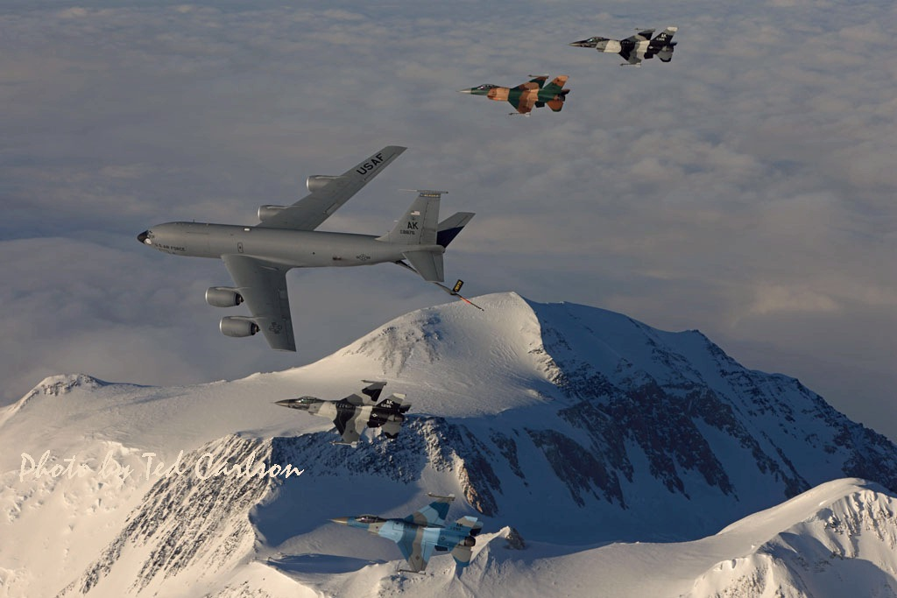
354 FW Mission Overview

Slide 19
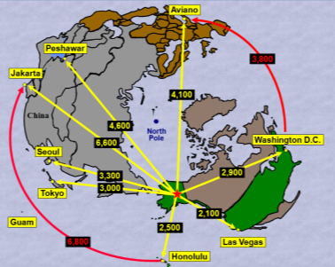
354 FW Mission Overview

Slide 20

354 FW Mission Overview
PARC
107,800 sq. km.
Nellis Airspace
7,400 sq. miles
JPARC
67,000 sq. miles

Slide 21
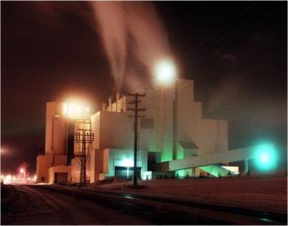
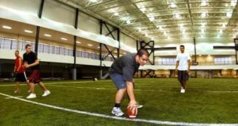


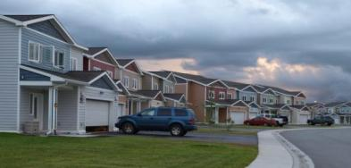
354 CES - Sustain
Facilities
Utilities – Completely off-grid
Infrastructure
Remote Ranges
AFTER
BEFORE
Notes:
New Housing Units
349 Homes Constructed (216 in Century Park North, 104 in Galaxy Heights, 29 in Raven’s Wood)
300 Homes Demo’ed in Sprucewood
99 Homes Renovated (95 in Broadway, 4 in Galaxy Heights)
Privatization Milestone Date
Issue Solicitation (Starting 60 day solicitation period) 08-Oct-10
Eielson: 801 Lender Consent to Assign Privatized Owner (PO) a Purchase Option 11-Oct-10
Eielson: AF/801 Owner Sign Letter of Intent to sell to PO 05-Nov-10
Select PO 15-Feb-11
Congressional Notification to Award to PO (ending) 07-Jul-11
Complete Negotiations with PO 22-Jul-11
Eielson: PO Closes on 801 Purchase 26-Sep-11
Transaction Closing 26-Sep-11
Fitness Center Facility Amenities:
Main Gymnasium: NCAA regulation Basketball court with stadium seating for 800 3 Racquetball courts
Climbing Rock wall (25’)
Indoor track (1/10th of a mile track)
NFL regulation Artificial Turf Football/Soccer field (dimensions 225’ x 360’)
2 Aerobics area
Cardio Room /spin areas
2 weight rooms
Martial Arts/Boxing area (converted racquetball court)
Indoor pool (25 meters) Managed by Outdoor Rec
(2008) Combined HAWC and Indoor Track/Field area with FC ($24M)
Scheduled Facility Enhancements: (to older part of facility which was built in 1953) -$200K-TV Lounge/Entrance Doors/floor tiles (Completed Aug 10) -$22K (PCA) Parent Child Area (ECD 30 Oct 10) -$12K Martial Arts area (ECD 18 Oct 10) -$2M-Locker rooms/Hallways funding projected (Pending funding) -Resurface Pool deck and flooring (Pending funding)
Red Flag Impact: Increased patrons from 750 to 900+ daily usage

Slide 22

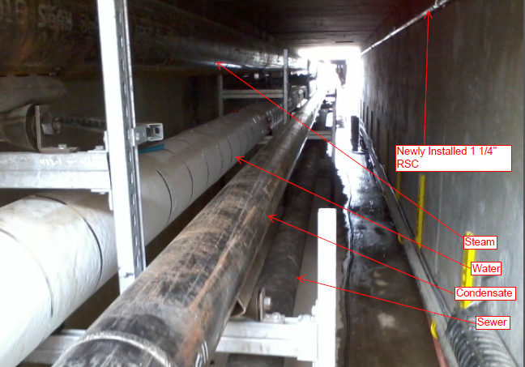
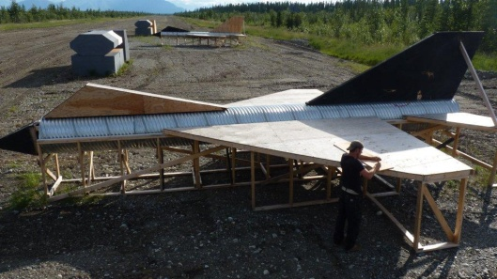
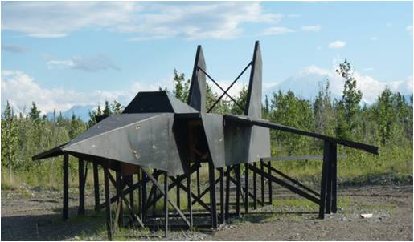
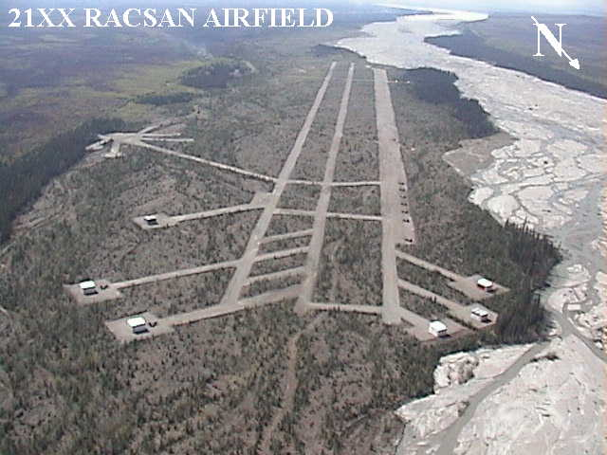
354 CES - Sustain
Utilidor Repair
Airfield Winter Operations
Target Build-up on Range
Notes:
CAO Dec 2013
Eielson’s new City Center Library, Internet Café, Kids play area, Teen Center
Re-utilize old BX (45k SF)(1956)
New Library (14k SF)(limited to $700K)
New Children’s Play Area (8k SF)
Repair elect, plumbing & fire suppression
Demolish old Community Center
95% Design Complete on 16 Jul 10
CoE execution – Award by 27 Sep 10
Est - $5M ($700K New Construction)

Slide 23
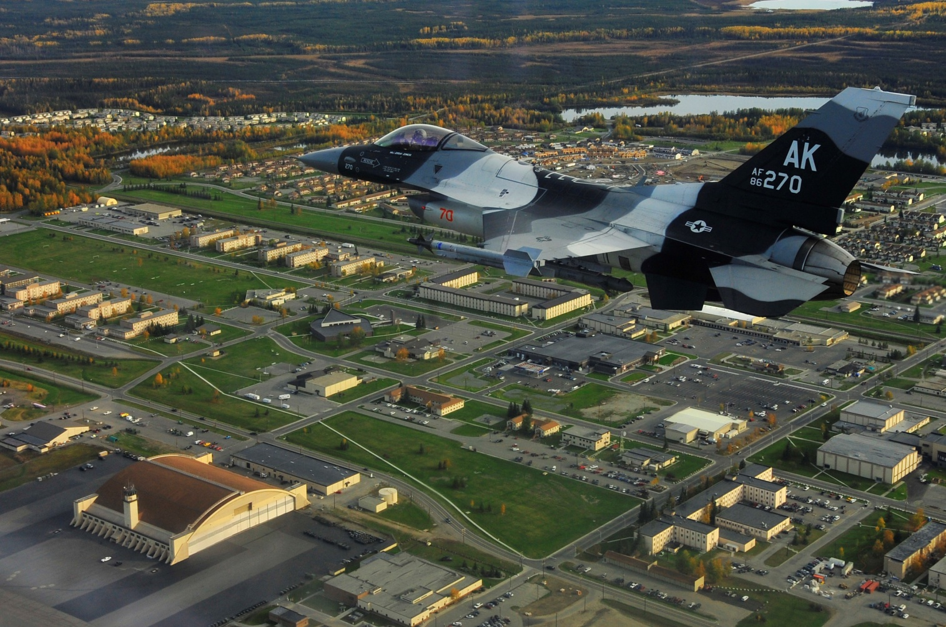

Slide 24
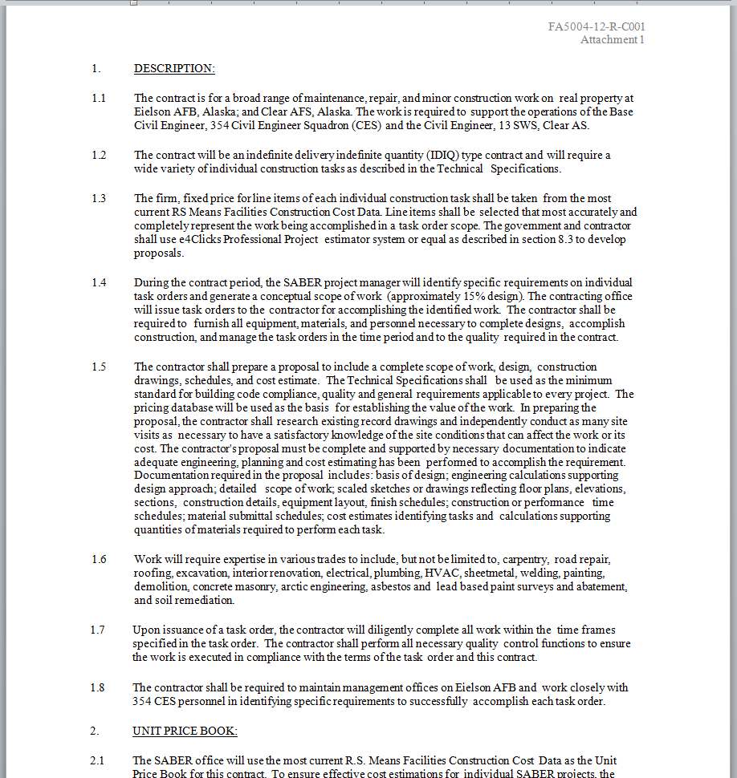
What is SABER at Eielson?
IDIQ contract vehicle – Indefinite Delivery, Indefinite Quantity
1 year base contract, 4 option years
Currently single award – awarded to one prime contractor
Augments organic construction capability

Slide 25
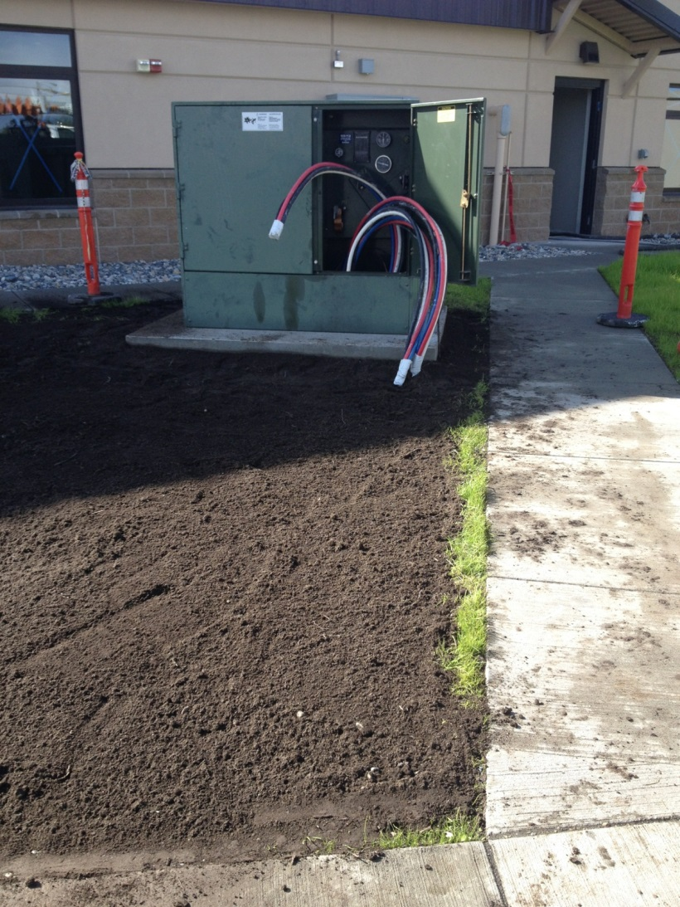
What is SABER at Eielson?
Prime contractor acts as admin/project manager
Pricing negotiated using RS Means as UPG
TO value $25K - $750K
Design is not SABER Scope
Two part process
  1 Project Task Order (PTO) fee – buys the proposal
  2 Task Order Award – buys the project (PTO fee subtracted)

Slide 26
Requirement Identification
Internal
  Identified during emergency, preventive maintenance, or real property inspections
External
  Customer identifies a requirement or need
  New Mission Beddown (SATAF)
OR
Customer Service
  Assist customer to articulate needs
Work Request Review Board (WRRB)
  Approve/disapprove work requests
  Determine method of execution
CEN (Engineering Flight)
  Create Project
Notes:
Along with the asset management approach, there are other ways that work can be identified, such as internal. Or it could be external like a customer submitted a 332 or work request to us. Regardless of how the work is identified, if we are going to accomplish it, a 332 should be created and submitted through our personnel working in Customer Service.
From there, the work will get approved at the WRRB, which will also determine the method of execution. If the decision is made to not do the work in-house, it will likely get sent to the Engineering flight to be contracted out. This is how the work comes to you working in SABER.

Slide 27
SABER FY12

Slide 28
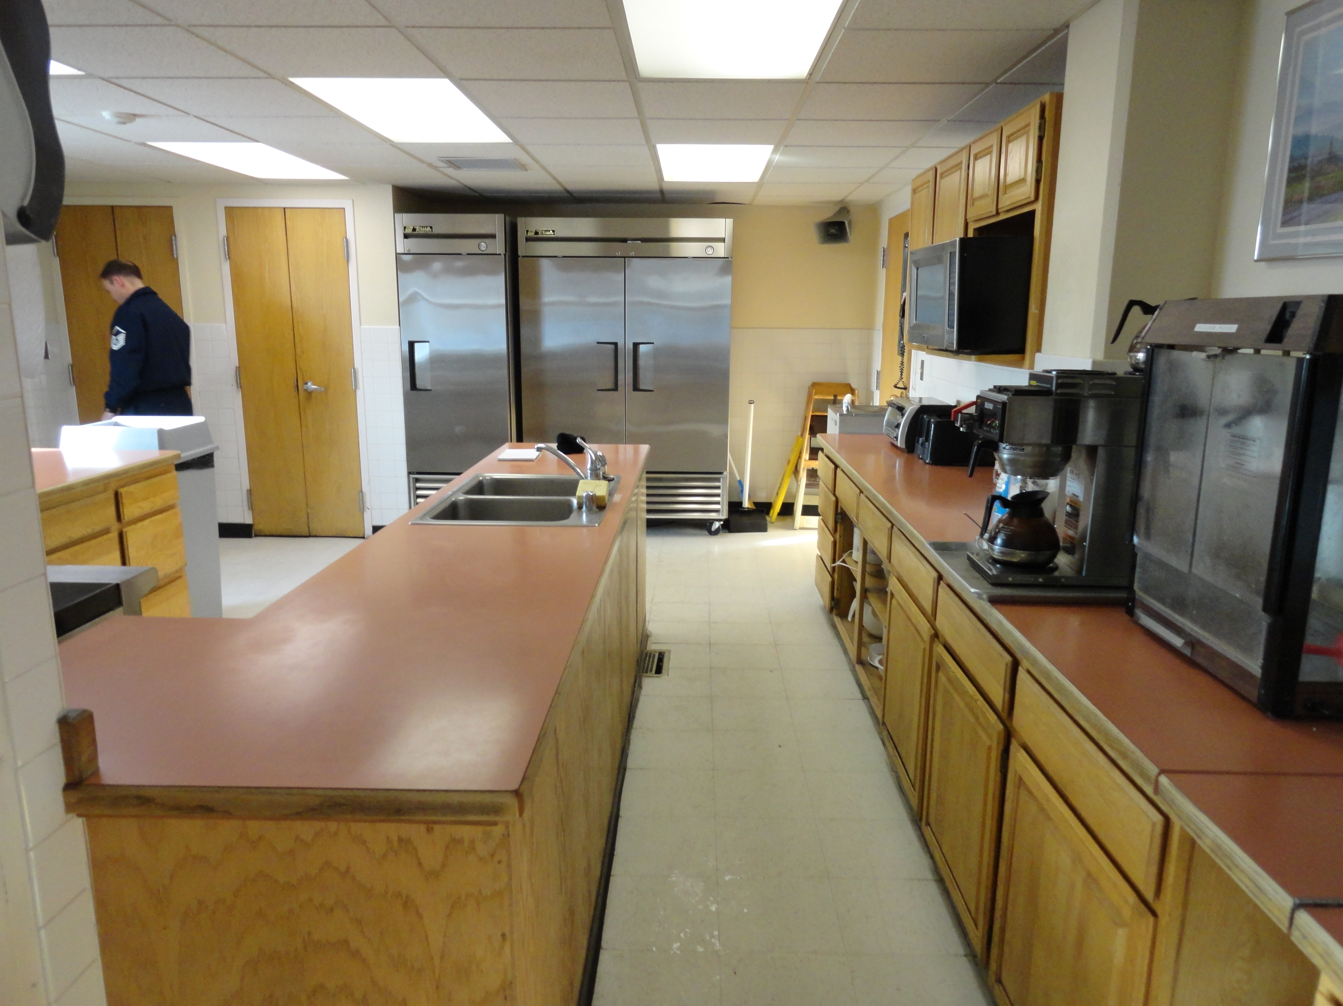
SABER at Eielson

Slide 29
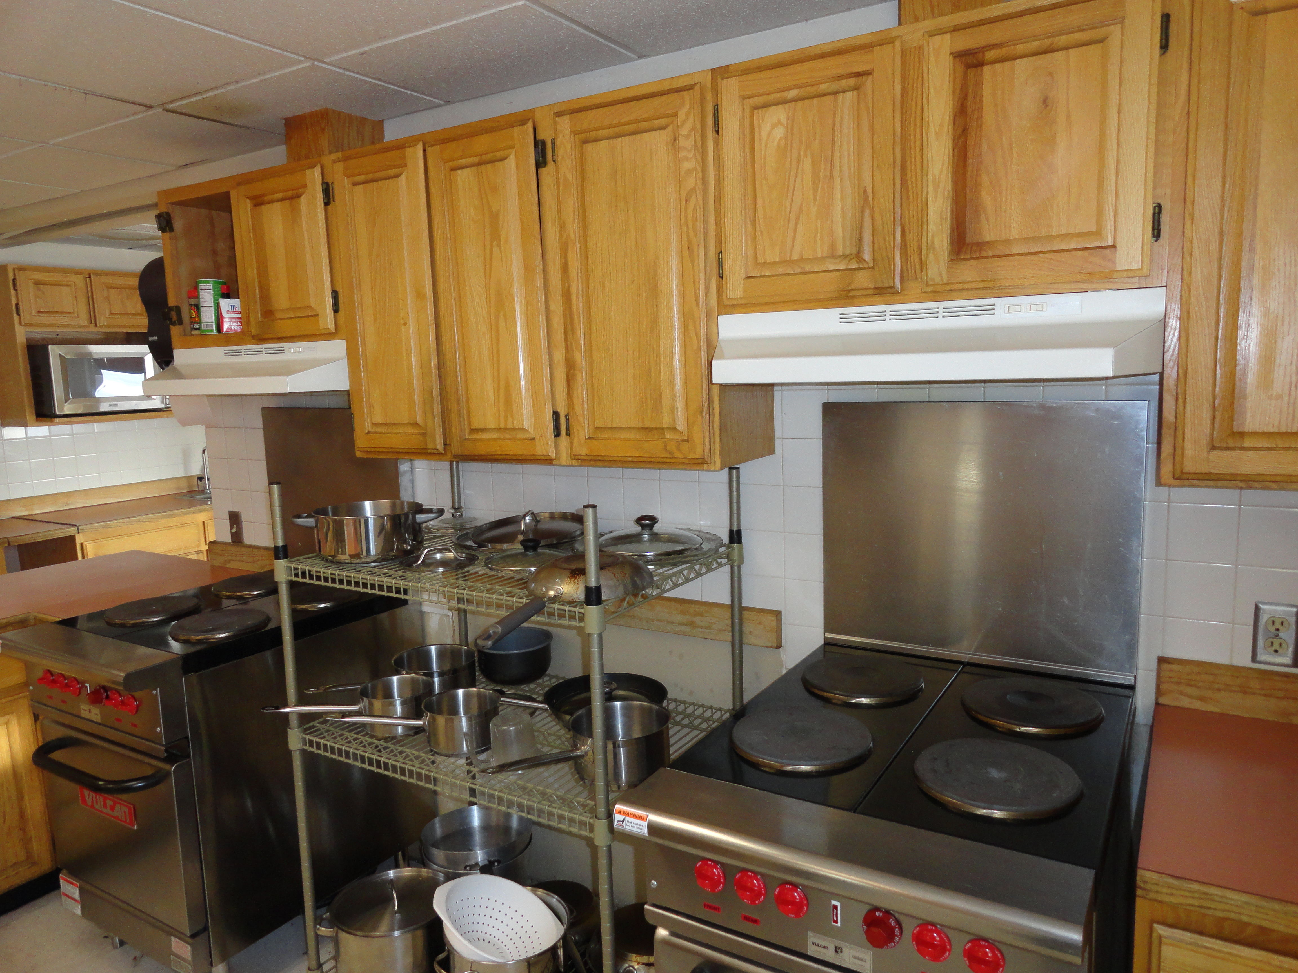
SABER at Eielson

Slide 30
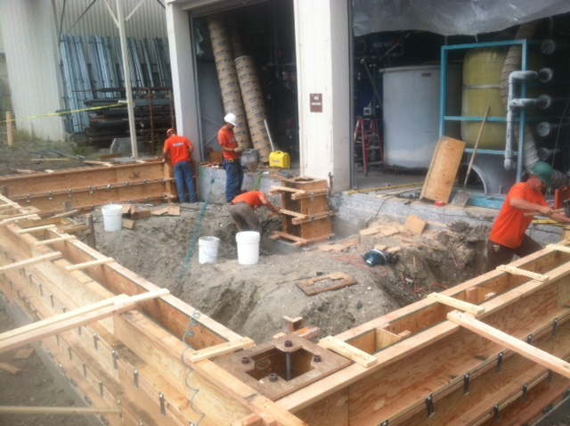
SABER at Eielson

Slide 31
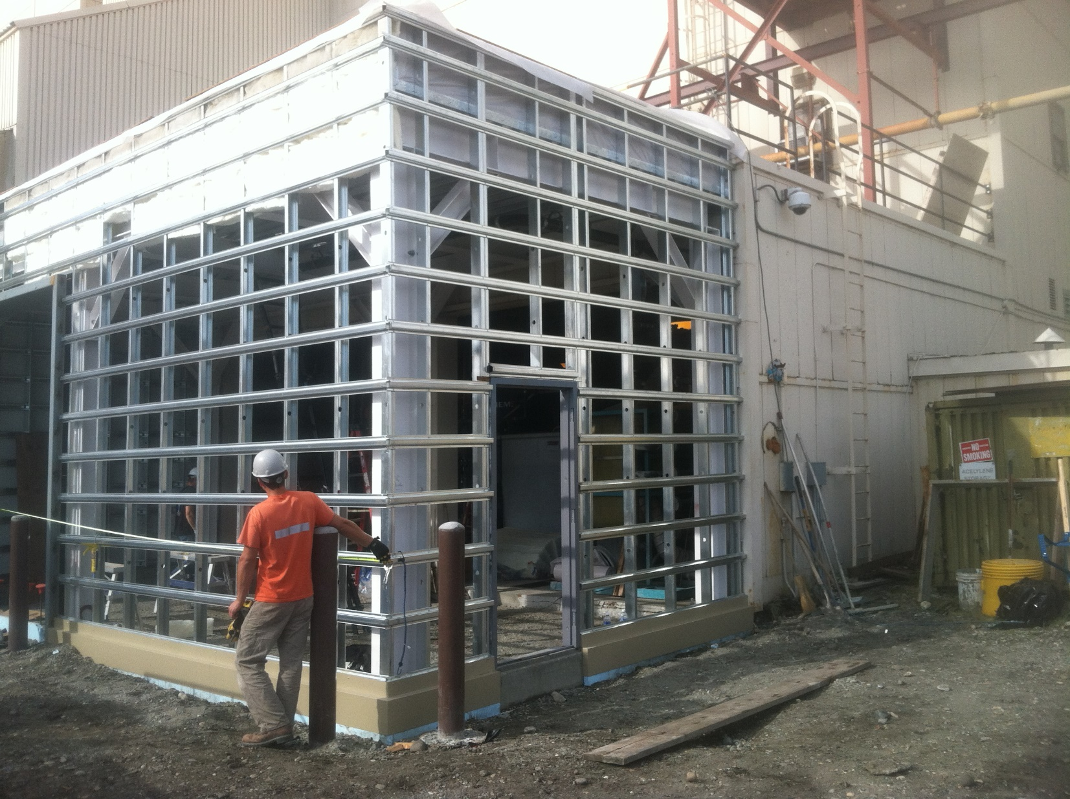
SABER at Eielson

Slide 32
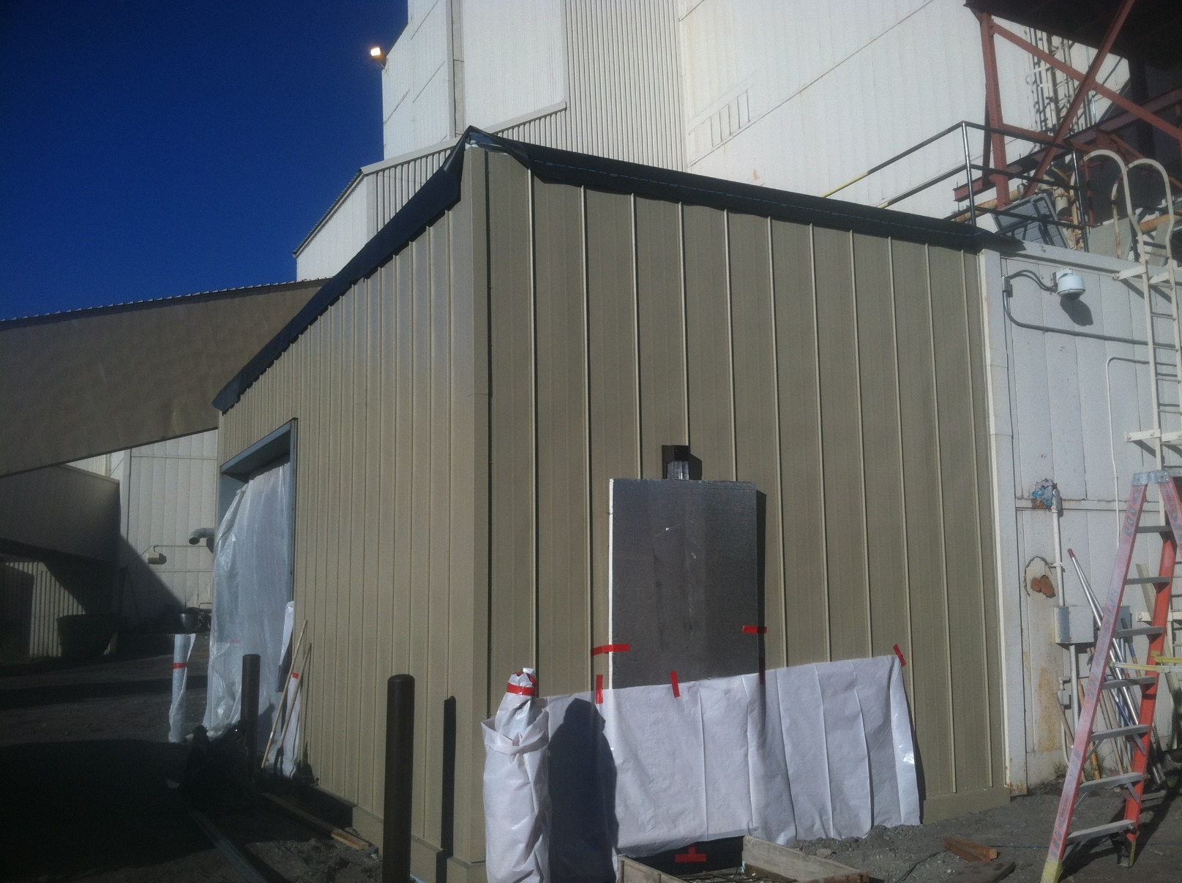
SABER at Eielson

Slide 33
SABER FY13

Slide 34
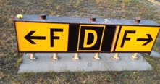
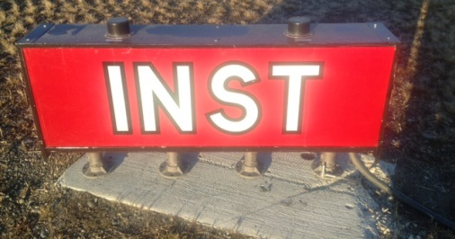
SABER at Eielson

Slide 35
SABER FY14

Slide 36
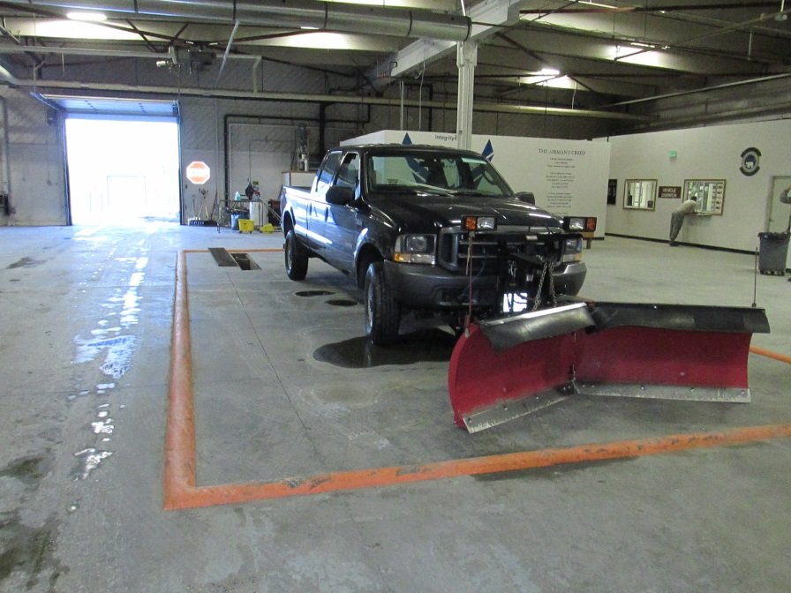
SABER at Eielson

Slide 37
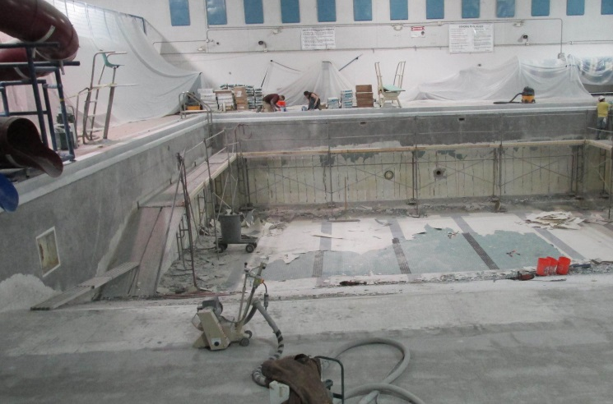
SABER at Eielson
Replace Pool Liner

Slide 38
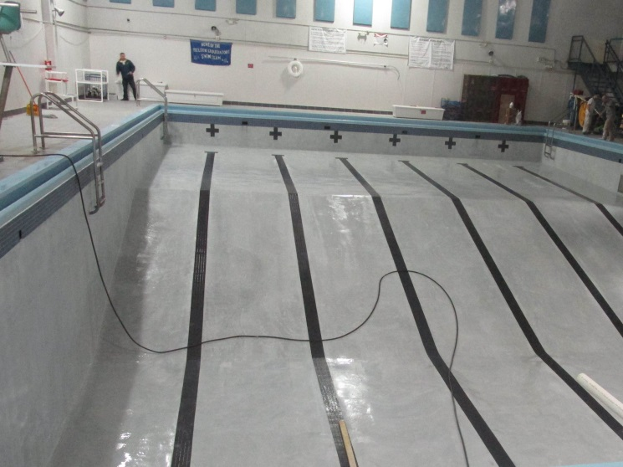
SABER at Eielson

Slide 39
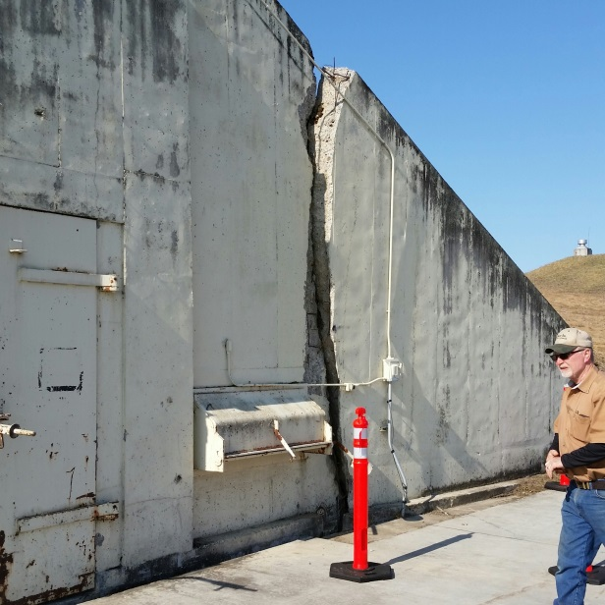
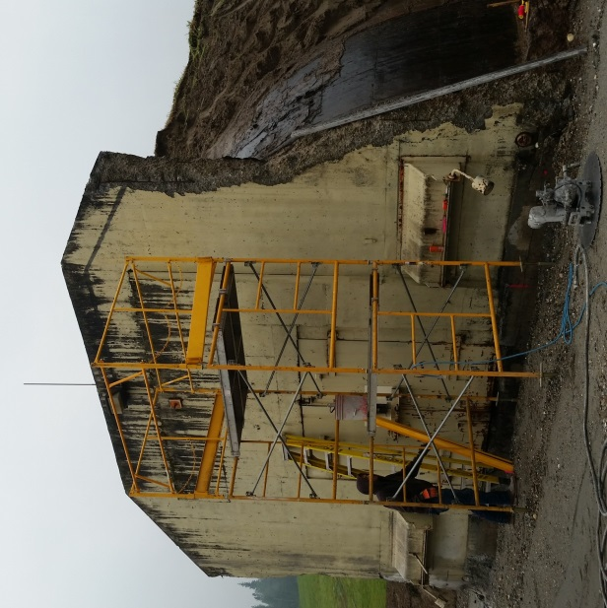
SABER at Eielson
Repair Munitions Storage

Slide 40
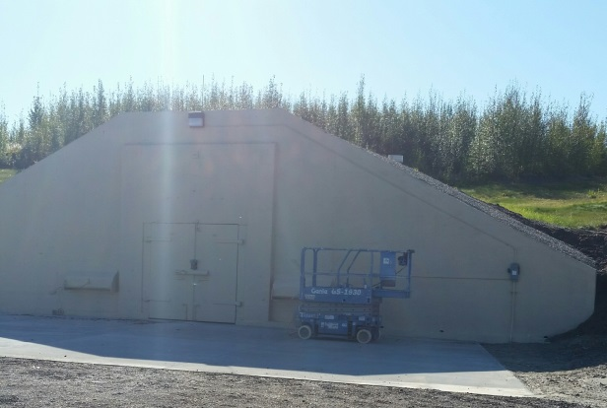
SABER at Eielson

Slide 41
SABER FY15

Slide 42
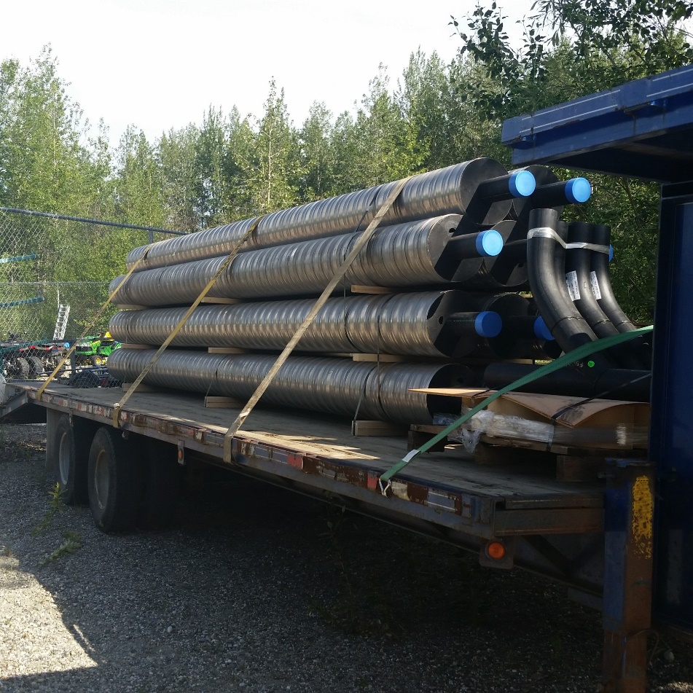
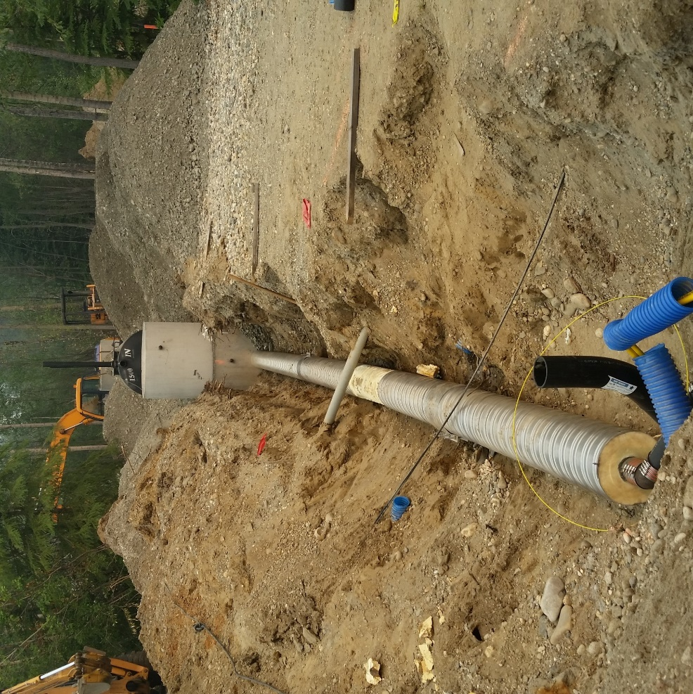
SABER at Eielson
Install Sewer/Septic at Remote Sites

Slide 43
SABER at Eielson
27
23
10
13

Slide 44
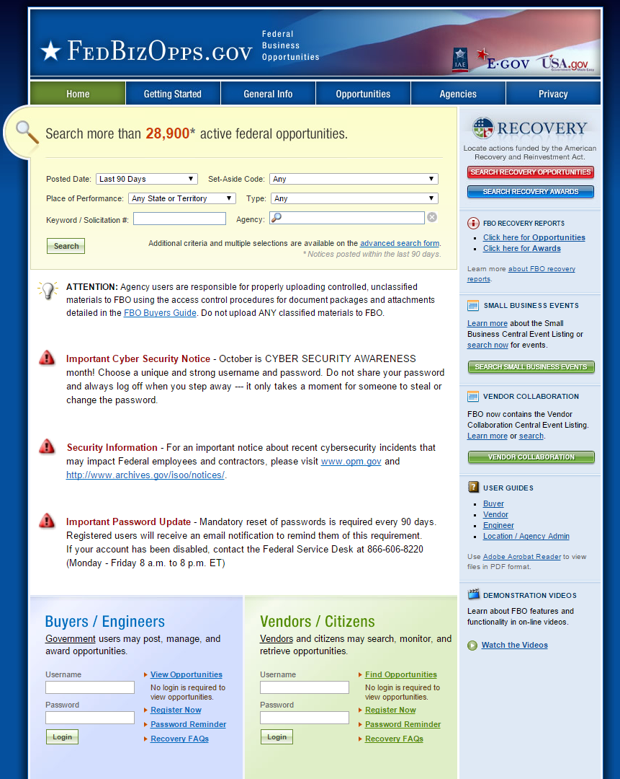
Future
Re-procure SABER for FY17-21
Future Missions at Eielson AFB

Slide 45
Questions?

